Slide 1
Case Study 1: PMBC Donors
Johnathan Lo, 2020

Slide 2
Description of the dataset
Data source: https://support.10xgenomics.com/single-cell-gene-expression/datasets/1.1.0/frozen_pbmc_donor_a, https://support.10xgenomics.com/single-cell-gene-expression/datasets/1.1.0/frozen_pbmc_donor_b
Datasets contain identical features and cell types but with batch effects due to temporal, spatial, and technical differences
Donor A: ~3000 observations, Donor B: ~8000 observations, 24k features each
Data from scRNA-seq

Slide 3
Experimental design
We use no integration (control), Harmony, UnionCom, and MMD-ResNet and evaluate using previously discussed methods
Merged datasets are treated in two ways before integration
with normal correspondence (i.e. full correspondence) between the features
With feature names altered to induce zero correspondence
Donor A data is then merged with Donor B and taken through standard preprocessing steps

Slide 4
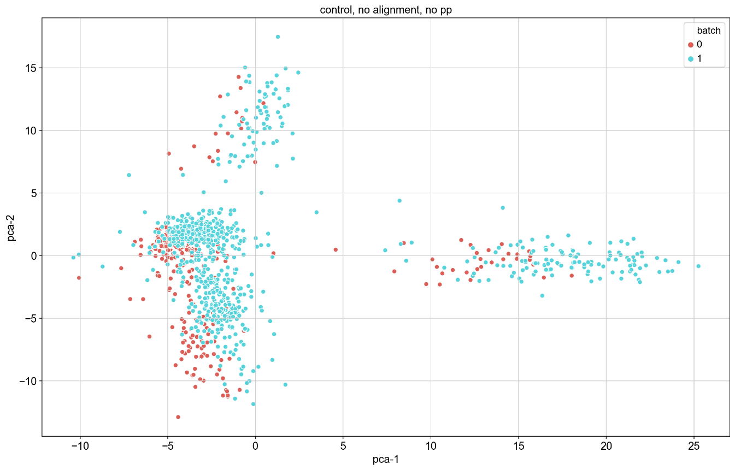
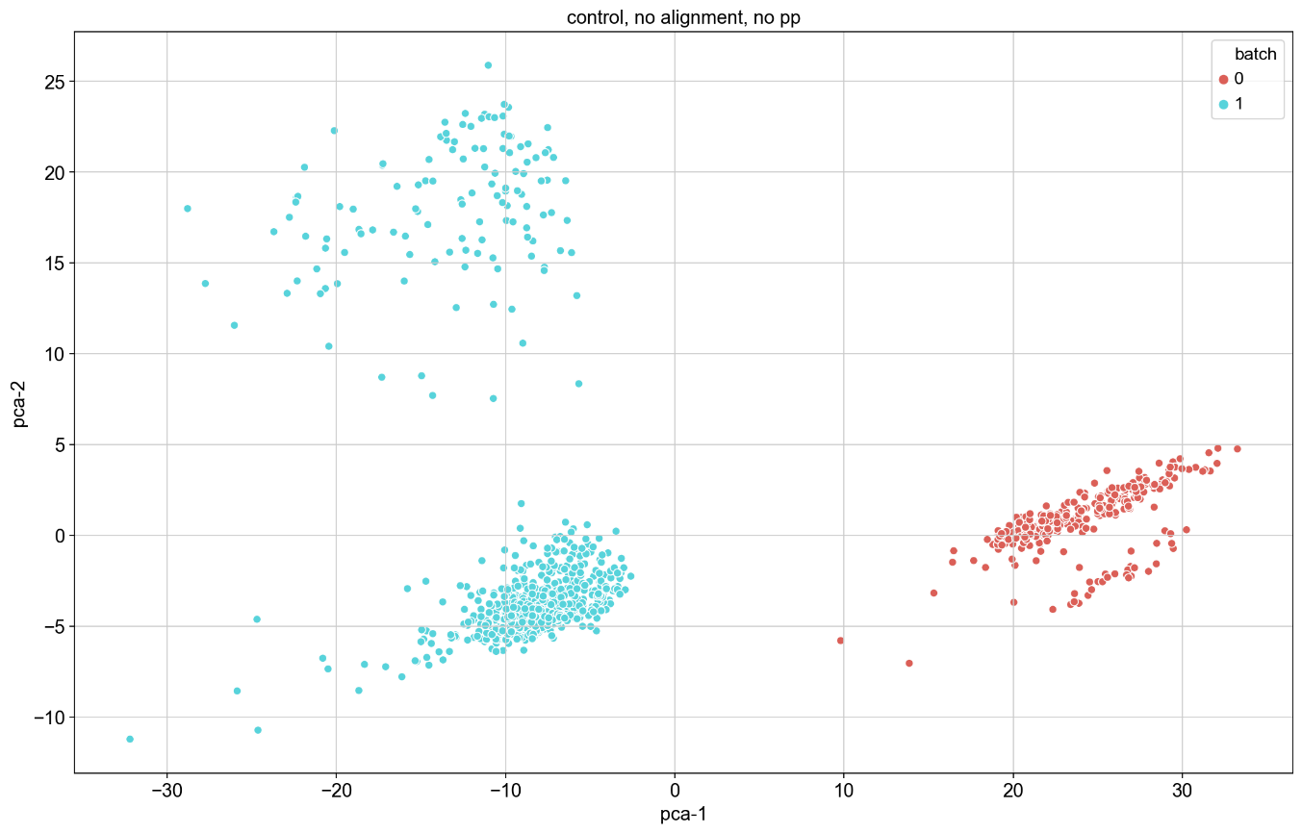
Results: Controls
PCA: left is with correspondence, right is without correspondence

Slide 5
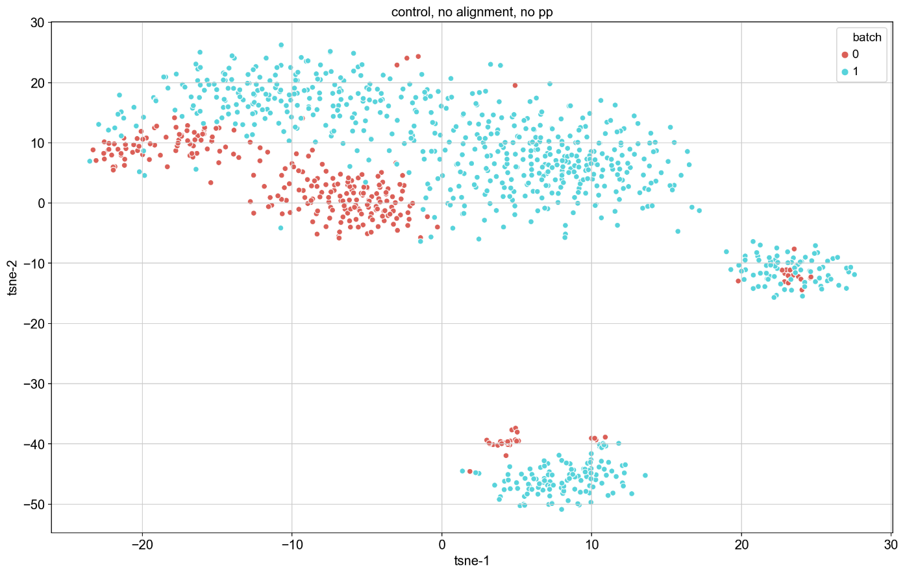
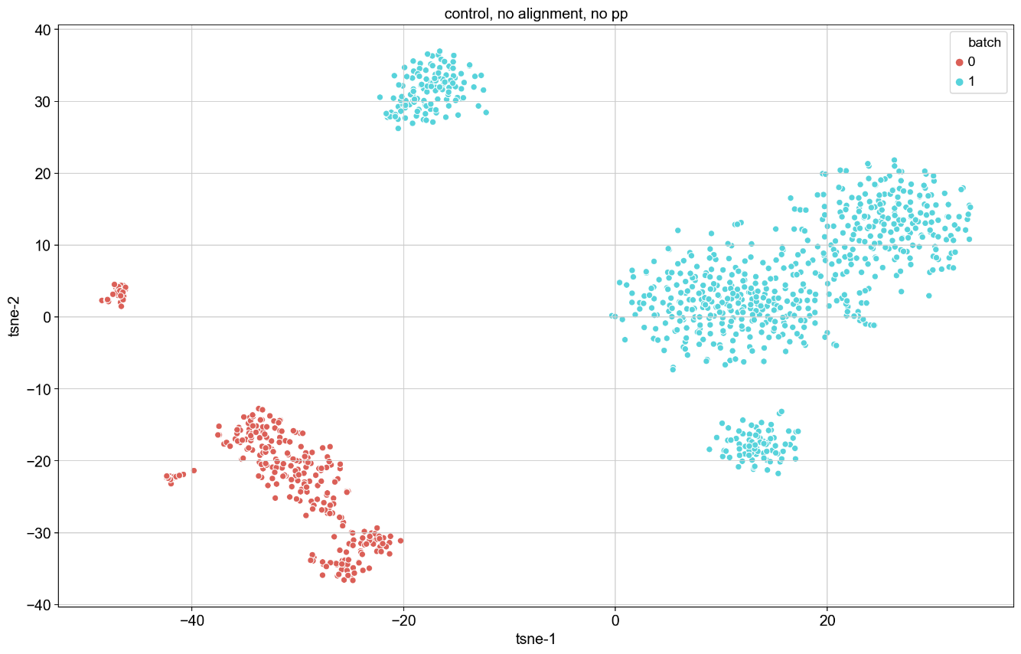
Results: Controls
t-SNE: left is with correspondence, right is without correspondence

Slide 6
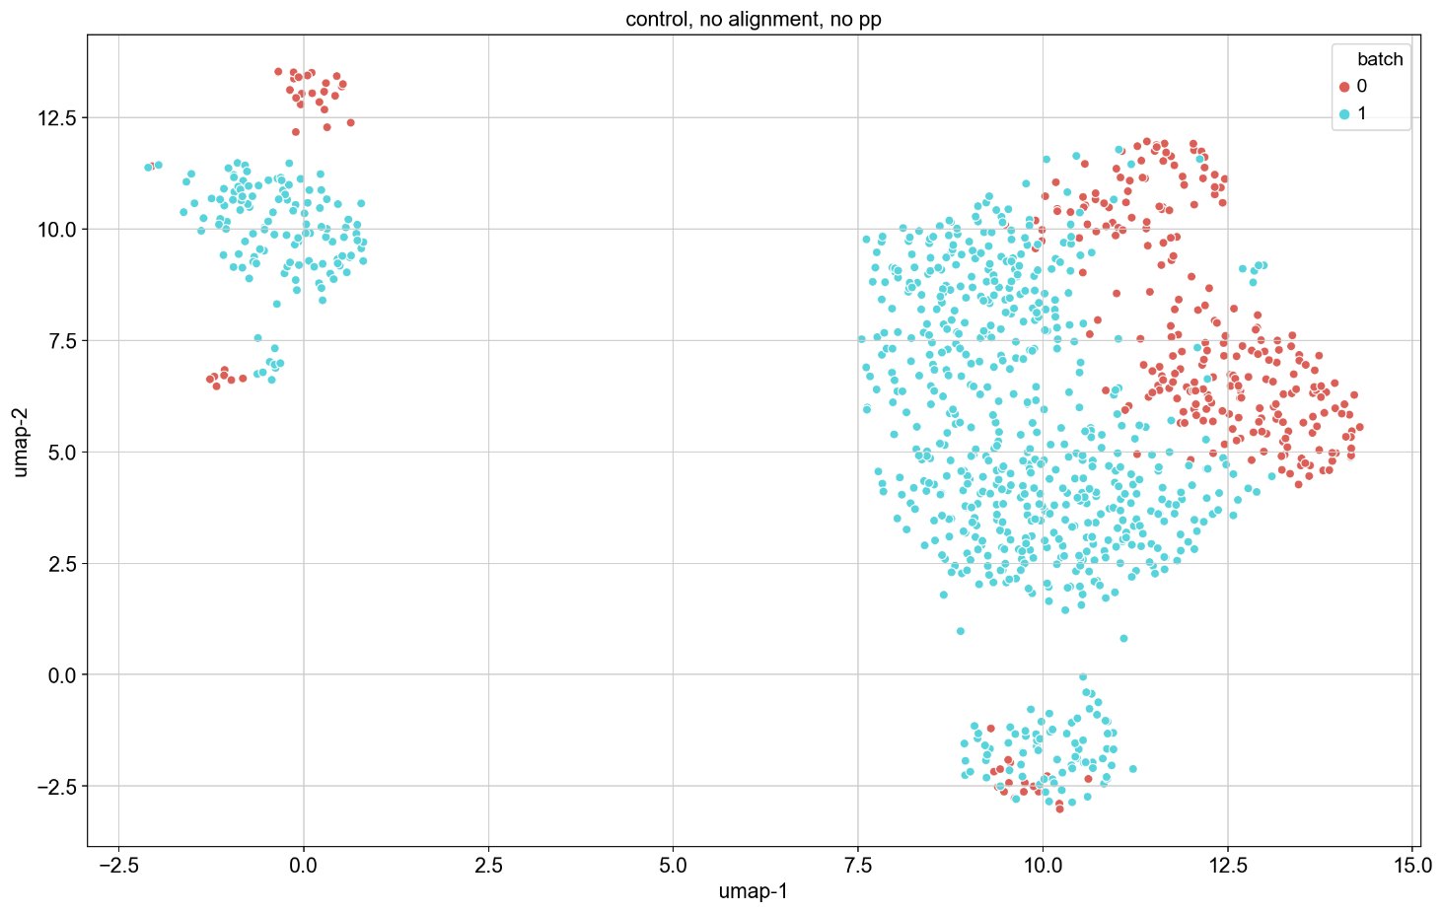
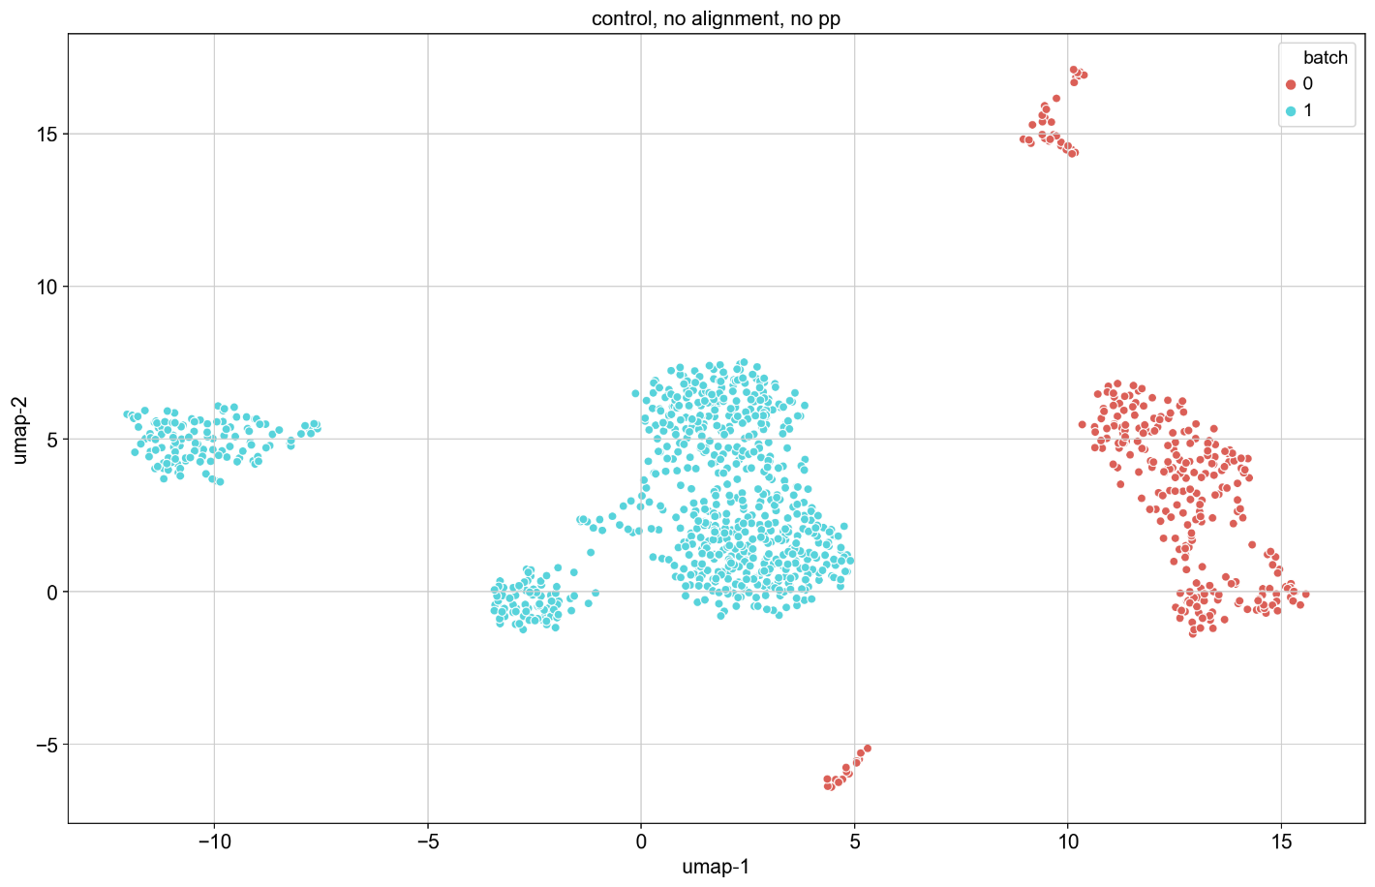
Results: Controls
UMAP: left is with correspondence, right is without correspondence

Slide 7
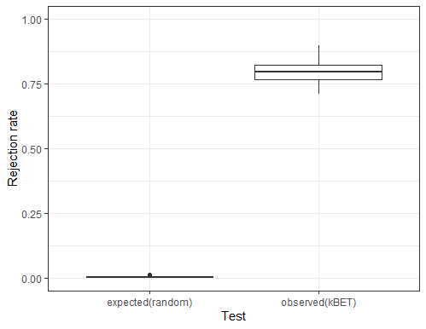
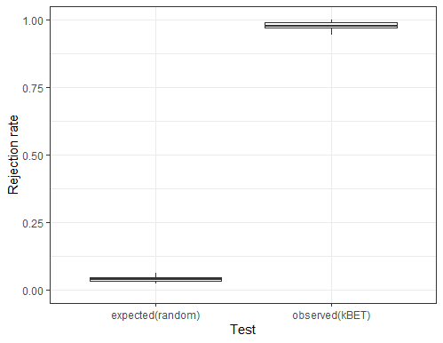
Results: Controls
kBET: left is with correspondence, right is without correspondence

Slide 8
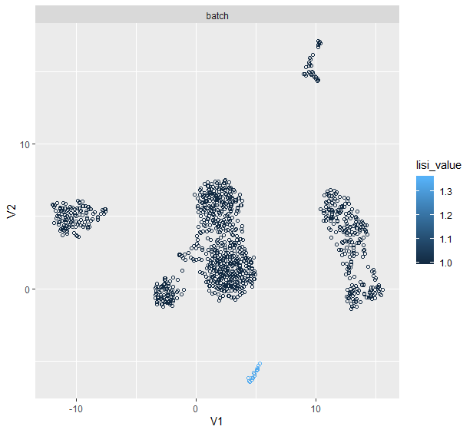
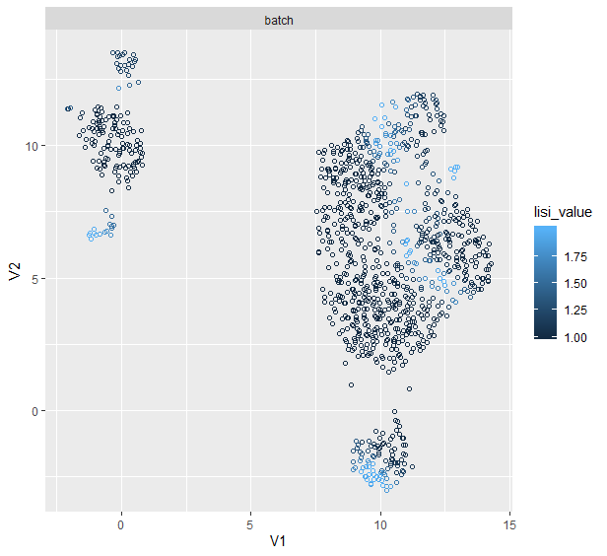
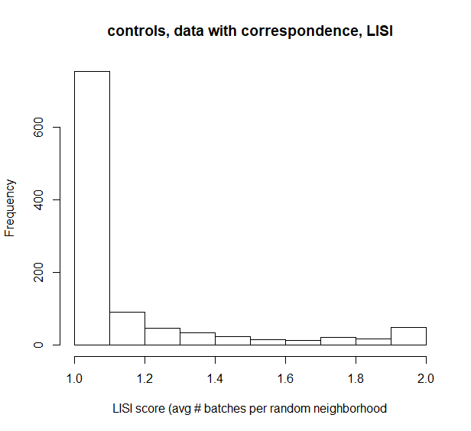
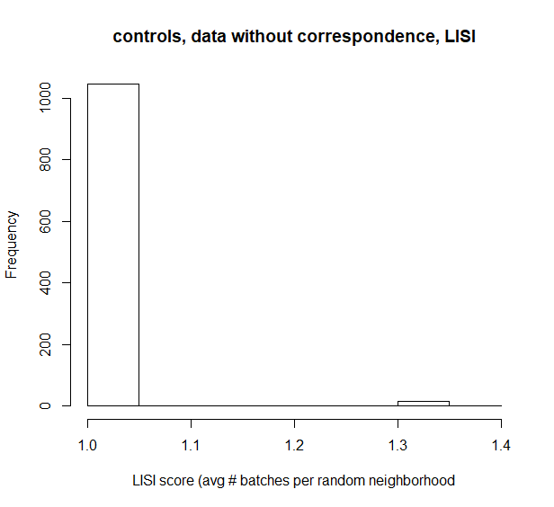
Results: Controls
LISI: left is with correspondence, right is without correspondence

Slide 9
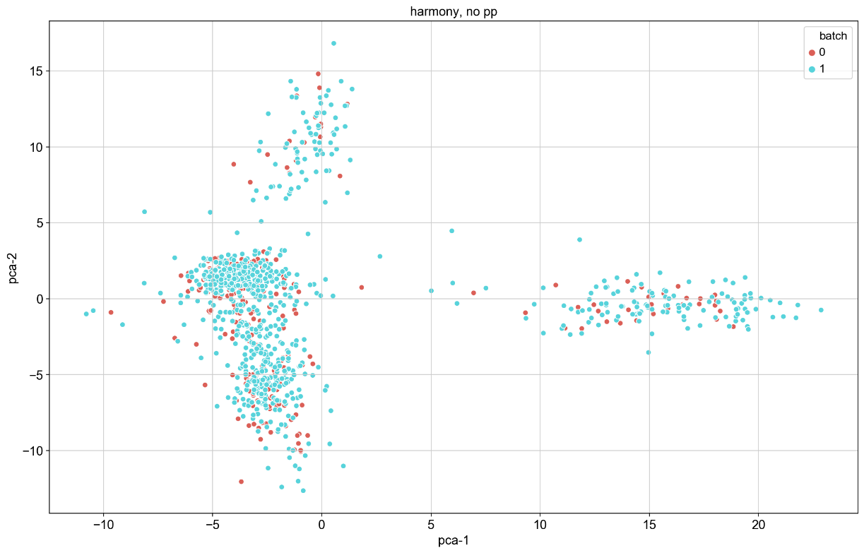
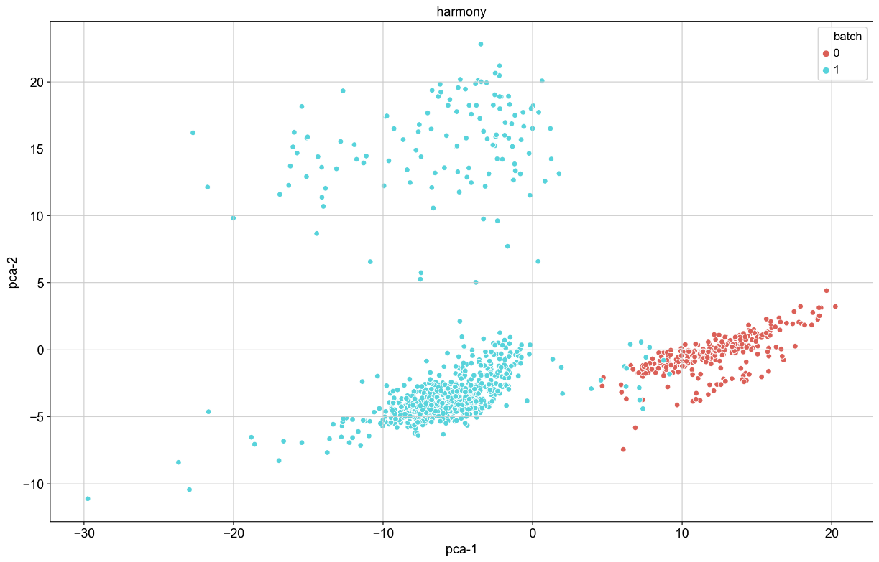
Results: Harmony
PCA: left is with correspondence, right is without correspondence

Slide 10
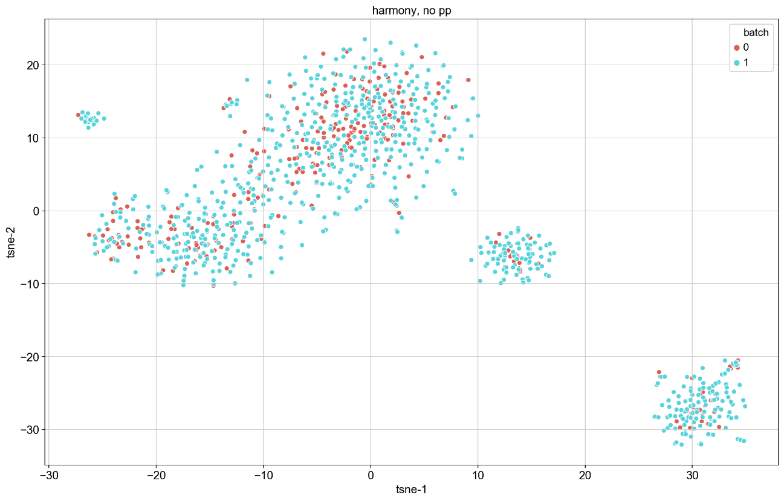
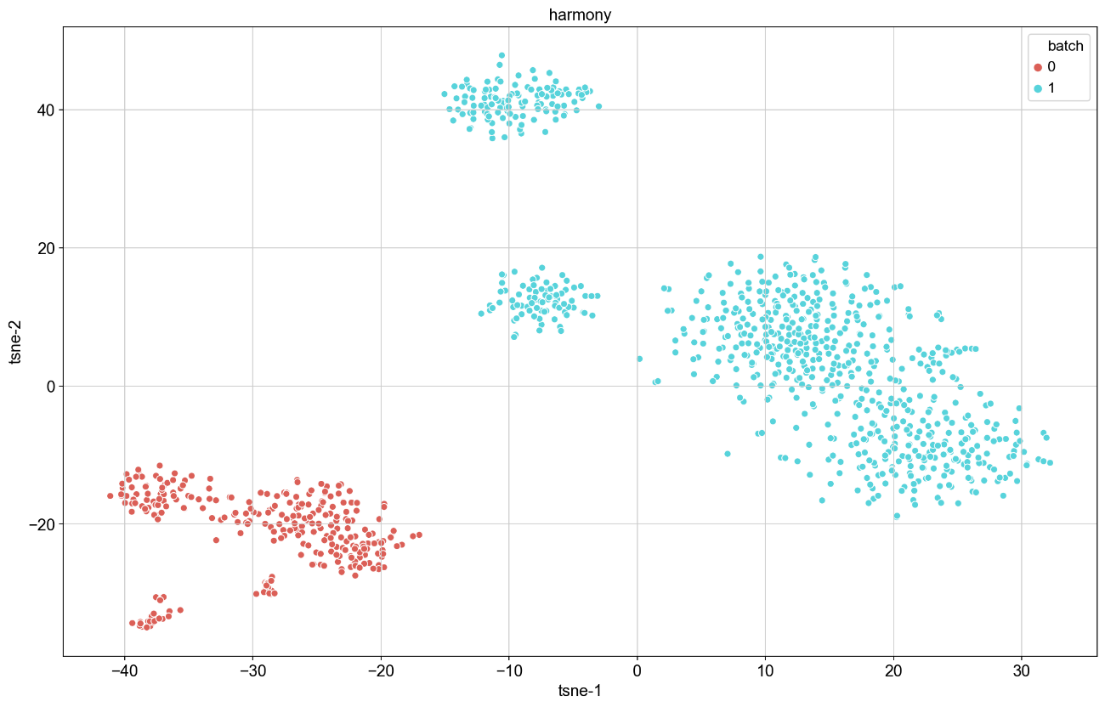
Results: Harmony
t-SNE: left is with correspondence, right is without correspondence

Slide 11
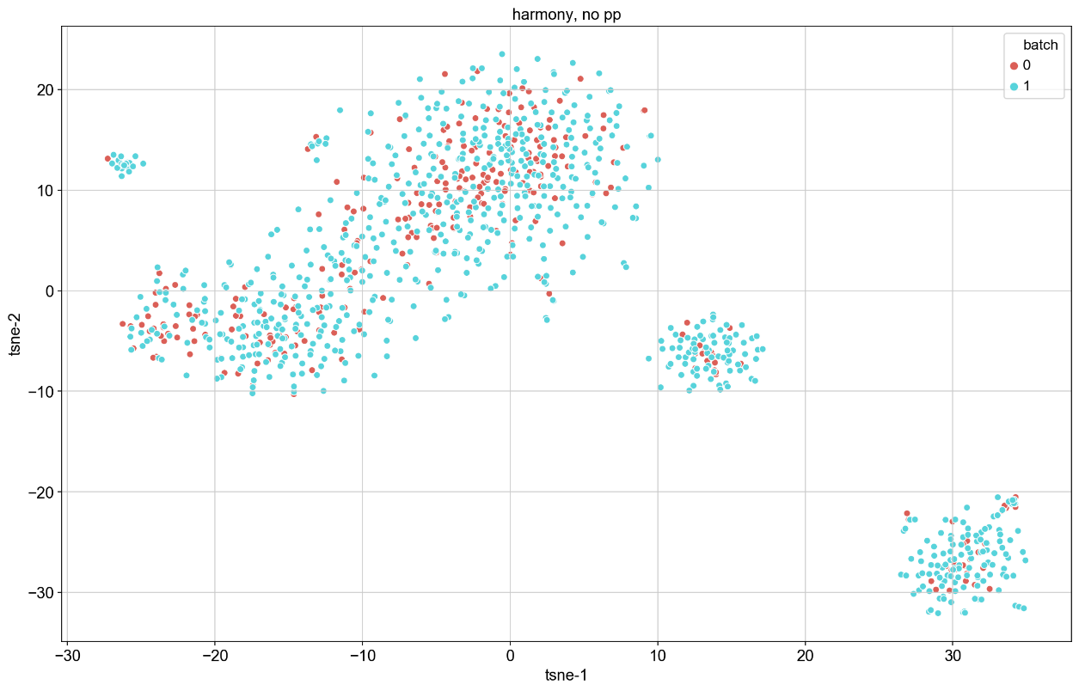
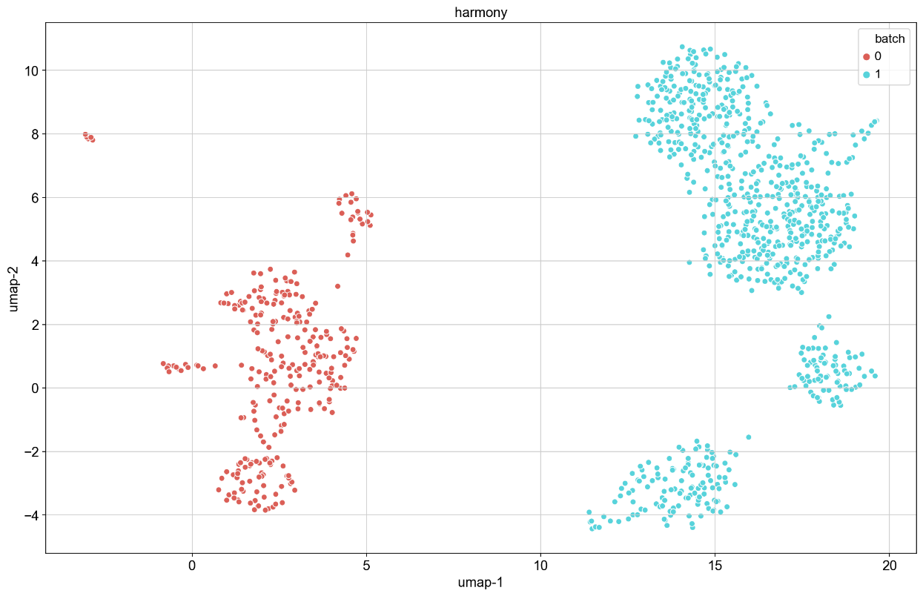
Results: Harmony
UMAP: left is with correspondence, right is without correspondence

Slide 12
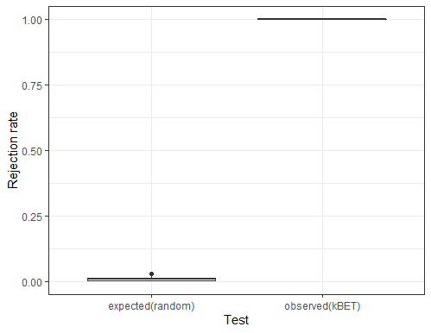
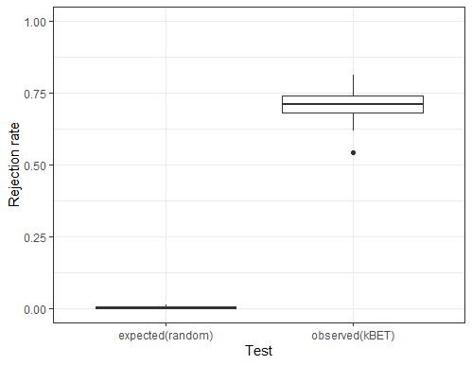
Results: Harmony
kBET: left is with correspondence, right is without correspondence (note apparent bug in kBET when observed approaches 0)

Slide 13
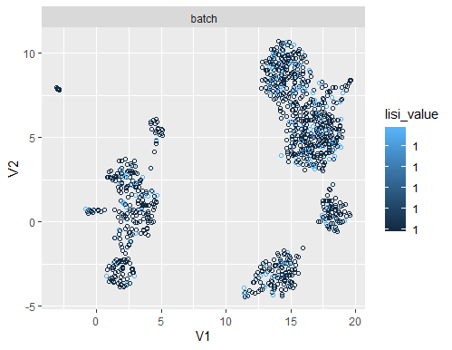
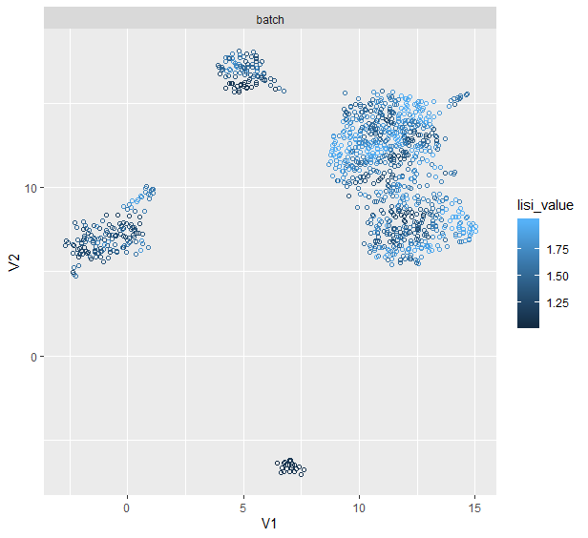
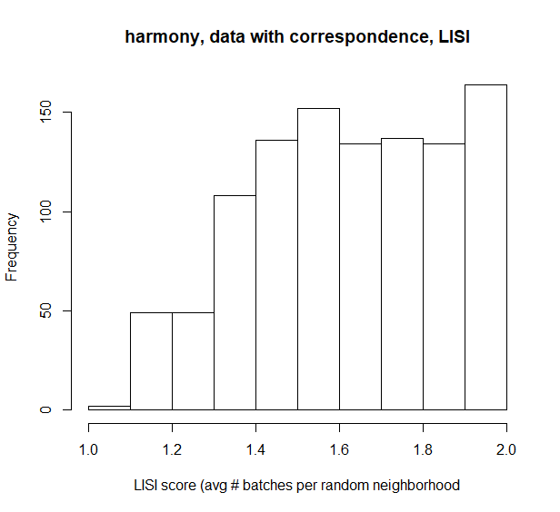
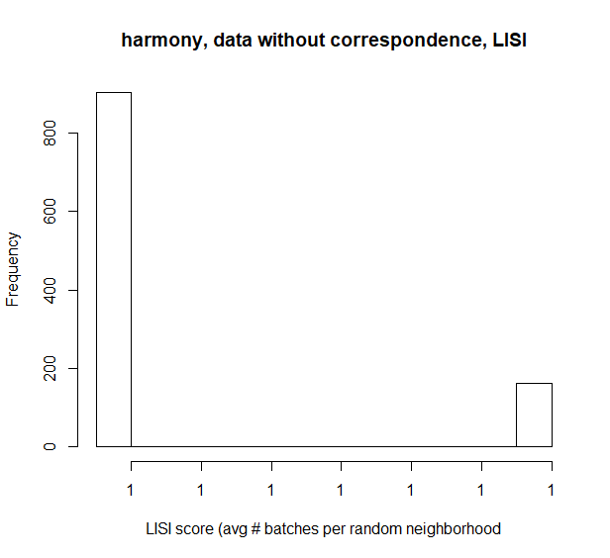
Results: Harmony
LISI: left is with correspondence, right is without correspondence (note bug when batches do not overlap at all)

Slide 14
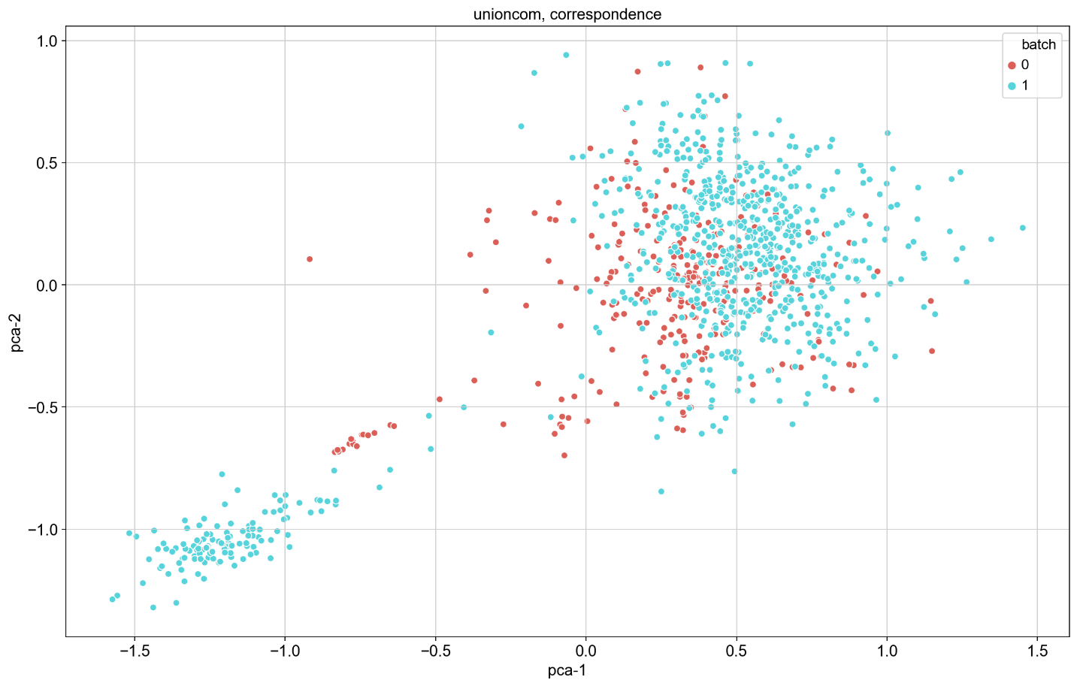
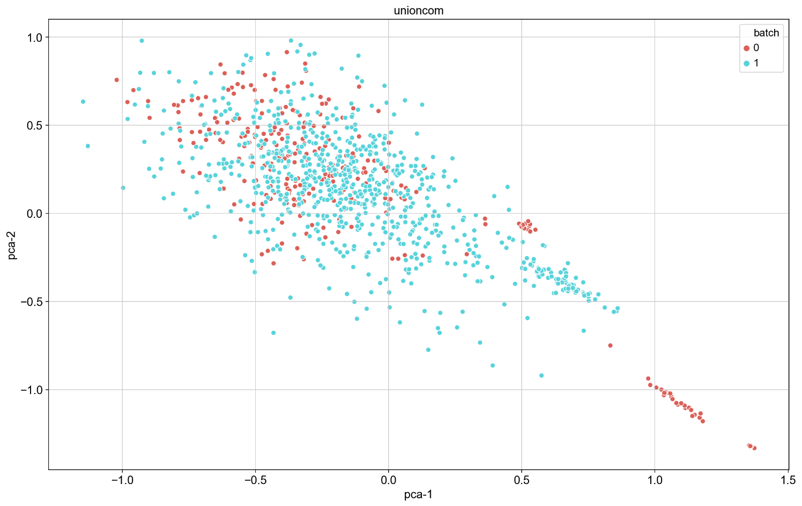
Results: UnionCom
PCA: left is with correspondence, right is without correspondence

Slide 15
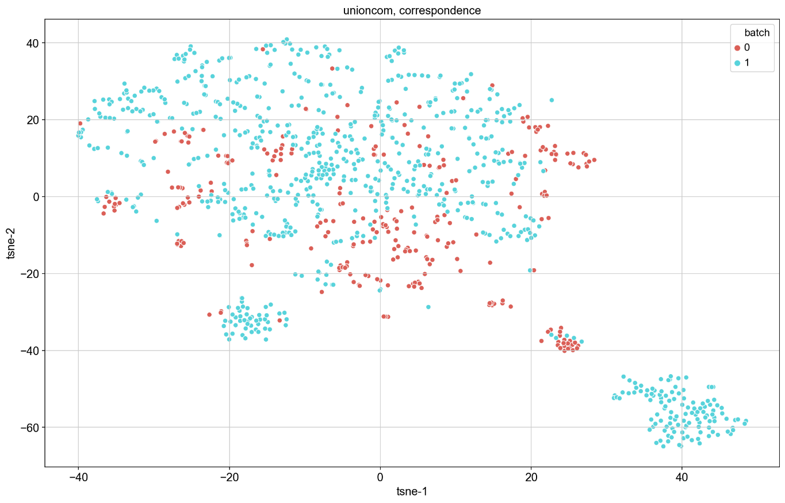
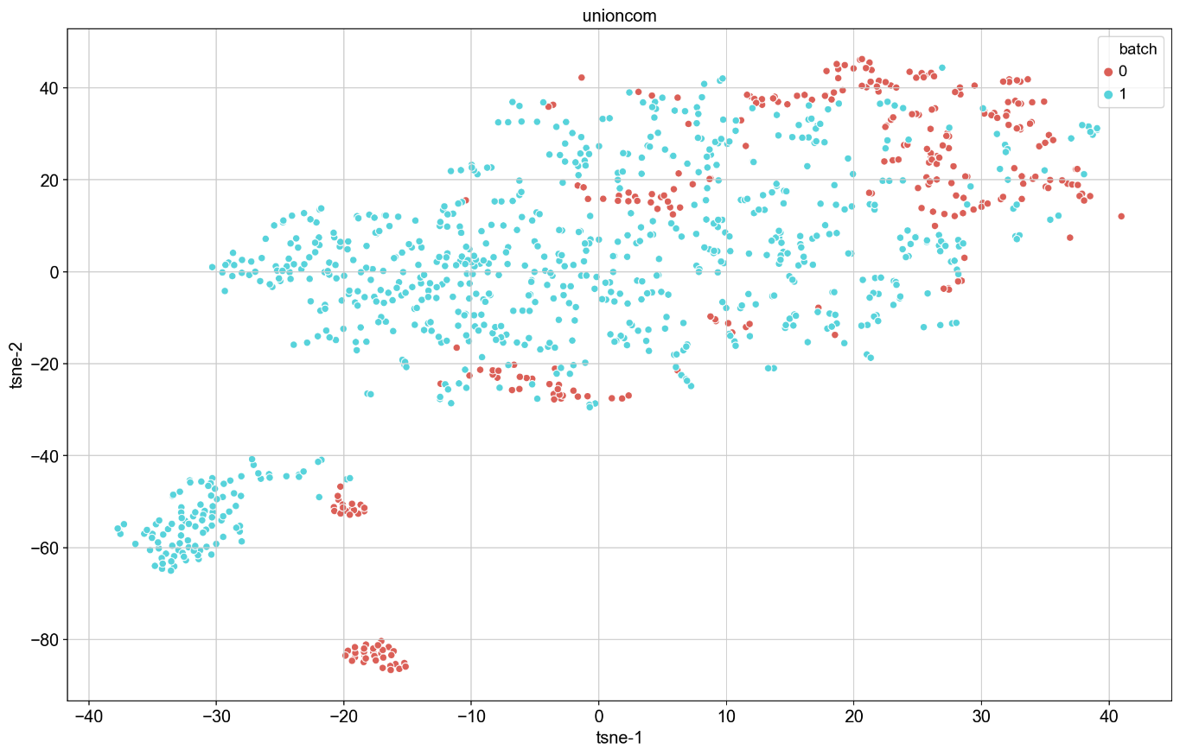
Results: UnionCom
t-SNE: left is with correspondence, right is without correspondence

Slide 16
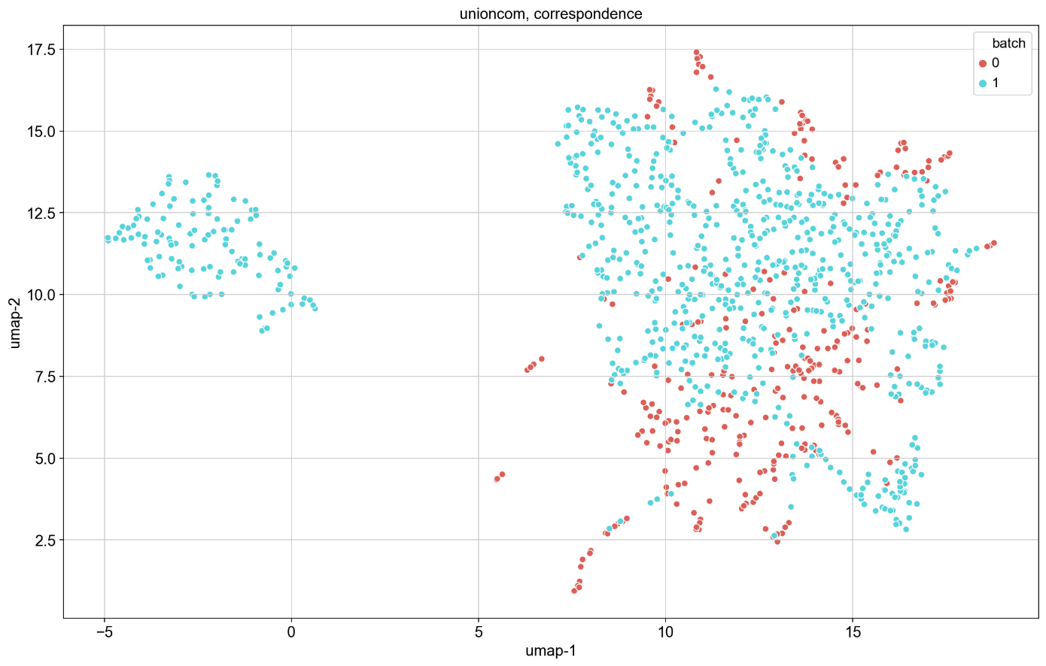
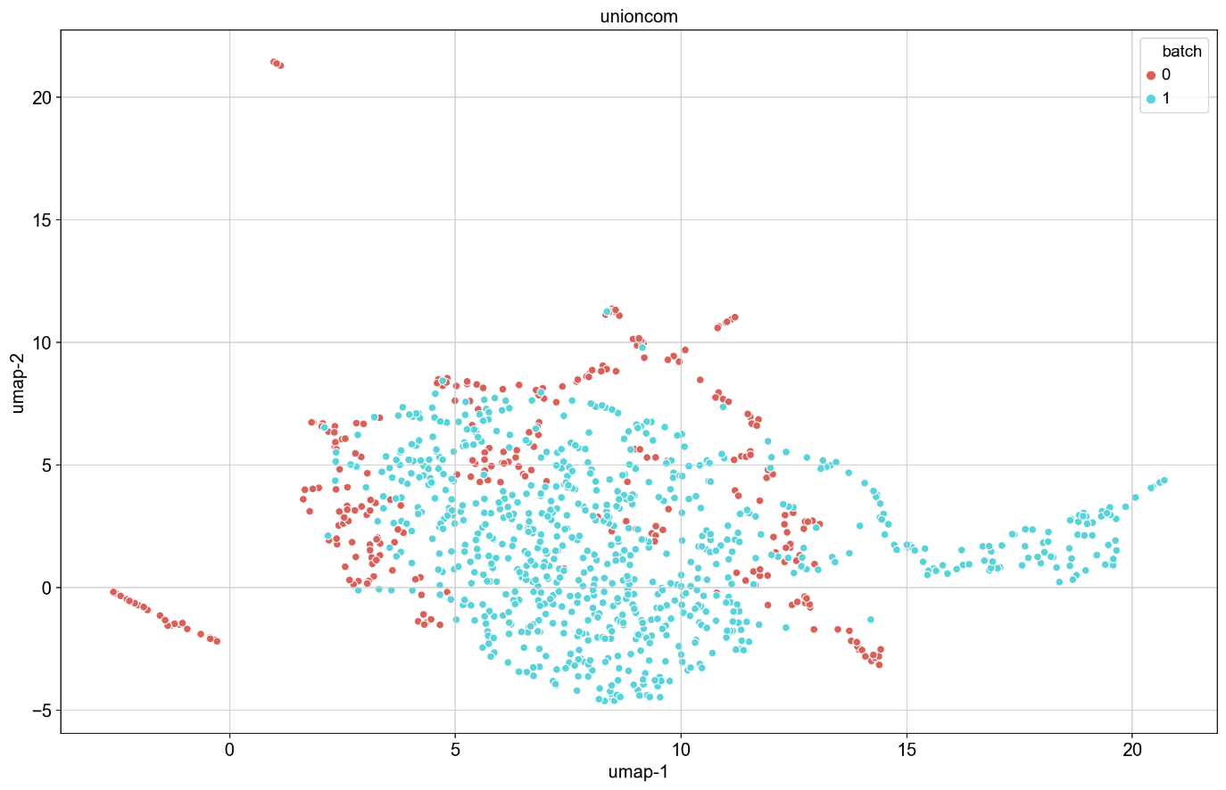
Results: UnionCom
UMAP: left is with correspondence, right is without correspondence

Slide 17
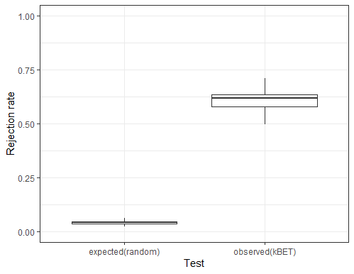
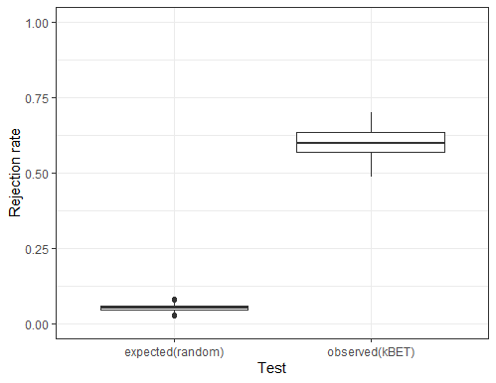
Results: UnionCom
kBET: left is with correspondence, right is without correspondence. Similar values for both correspondence and without!

Slide 18
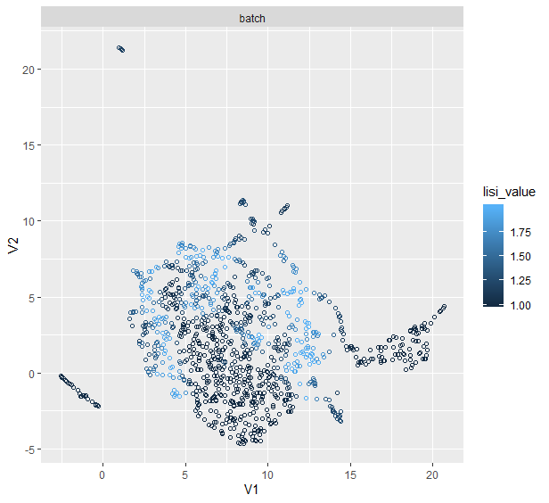
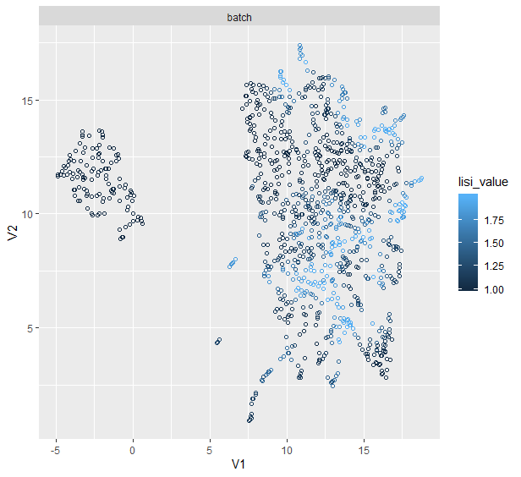
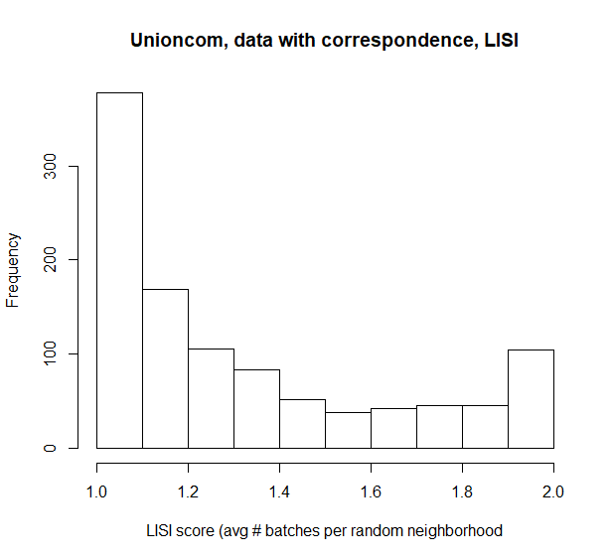
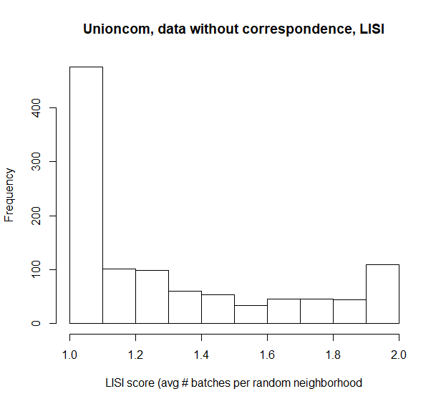
Results: UnionCom
LISI: left is with correspondence, right is without correspondence. Note similarities.

Slide 19

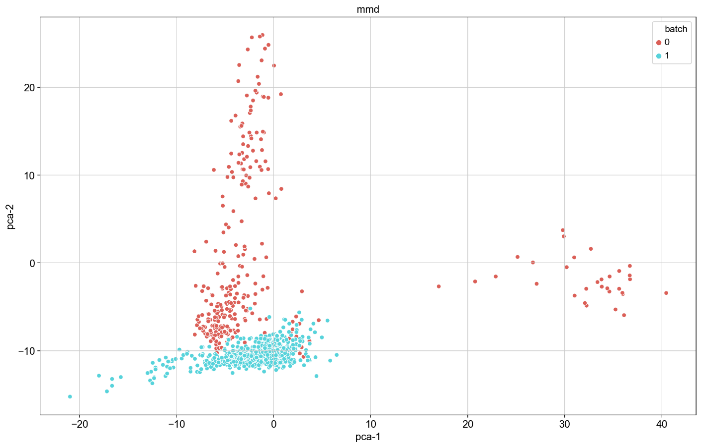
Results: MMD-ResNet
PCA: left is with correspondence, right is without correspondence

Slide 20
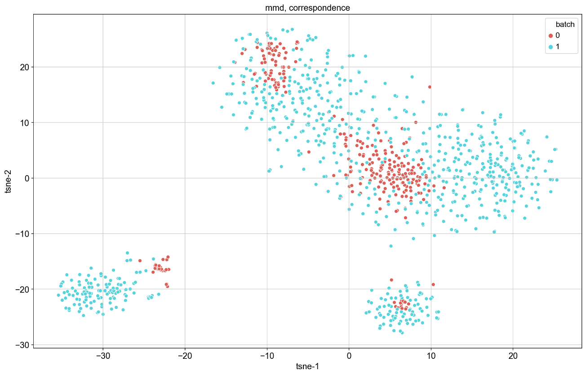
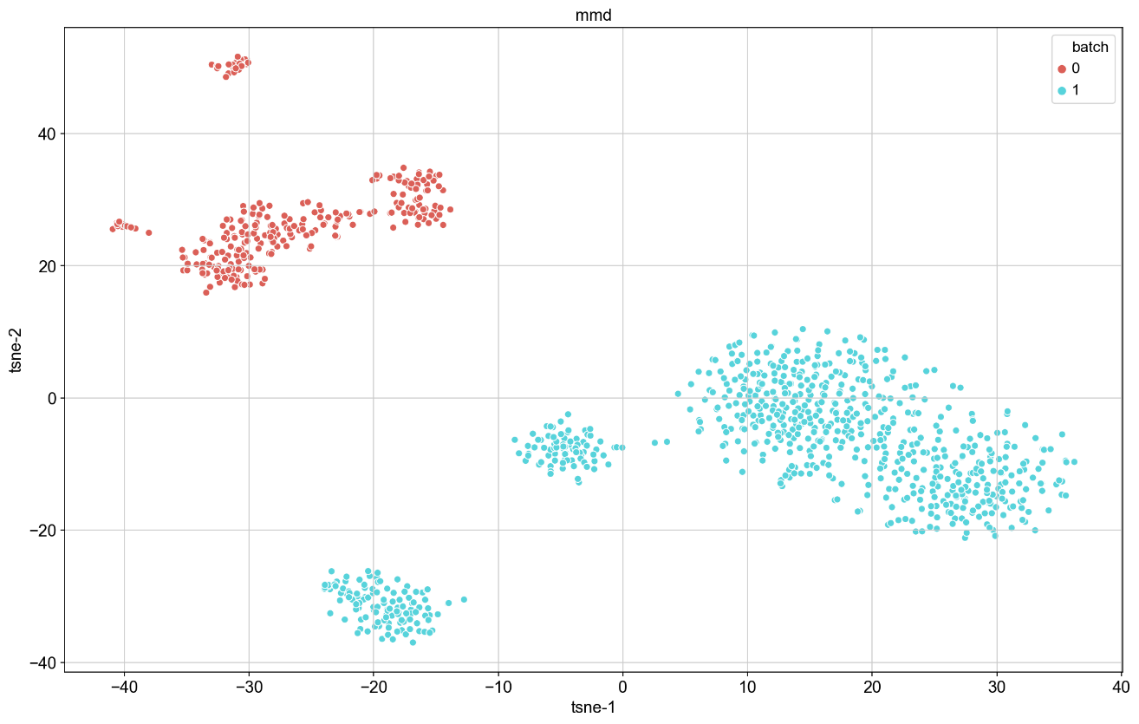
Results: MMD-ResNet
t-SNE: left is with correspondence, right is without correspondence

Slide 21
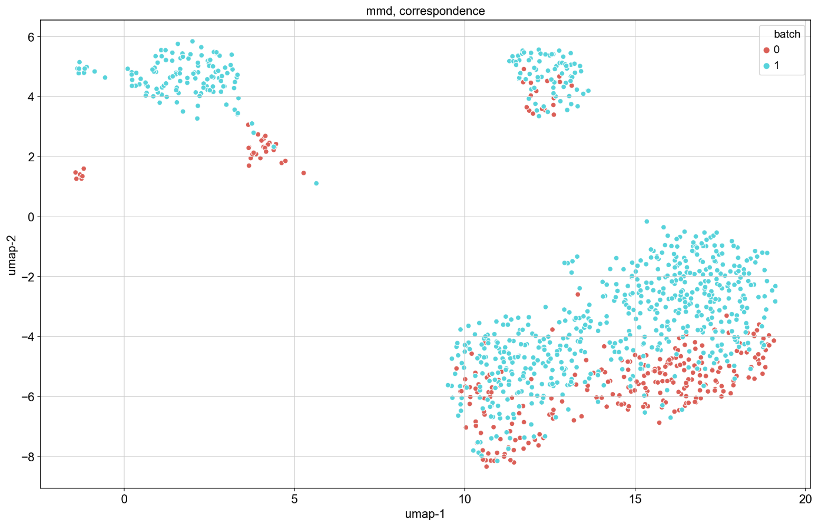
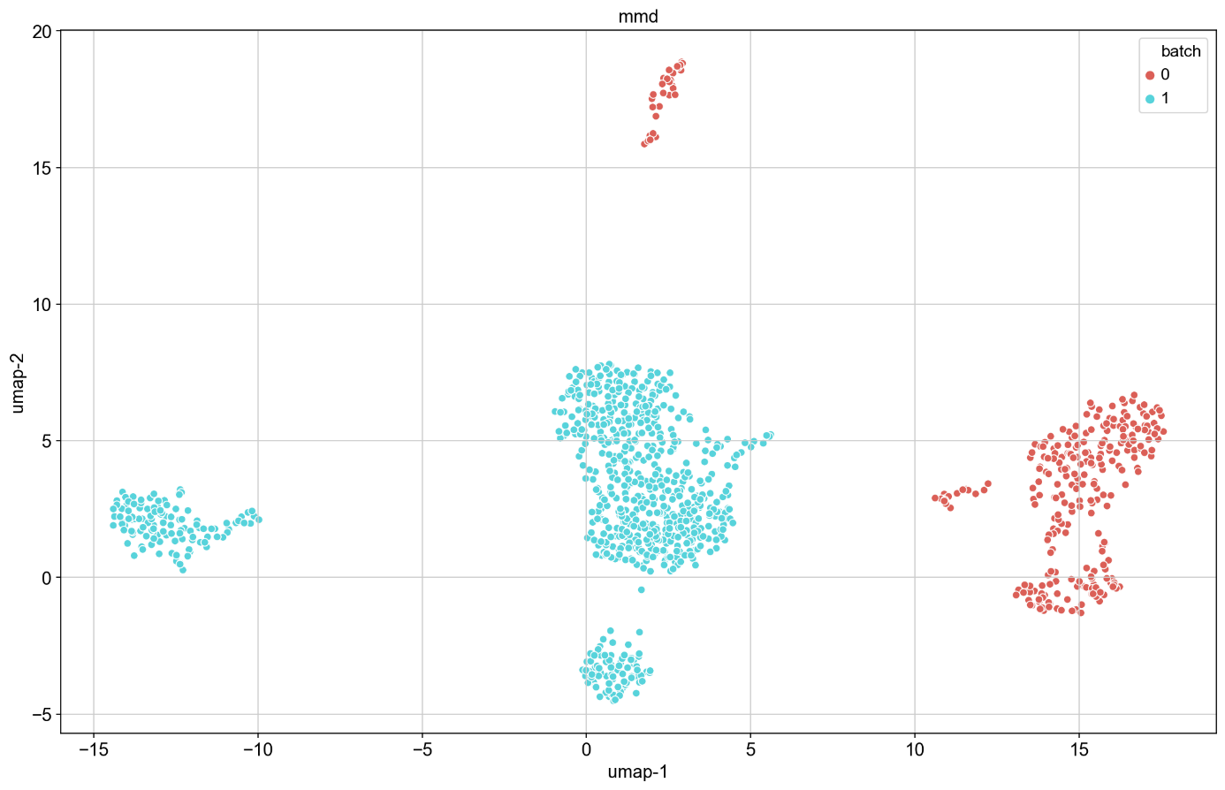
Results: MMD-ResNet
UMAP: left is with correspondence, right is without correspondence

Slide 22

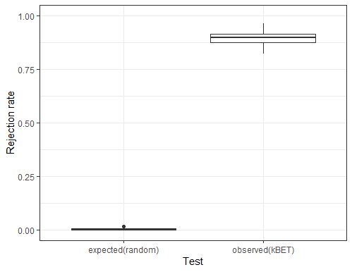
Results: MMD-ResNet
kBET: left is with correspondence, right is without correspondence. Note bug again.

Slide 23
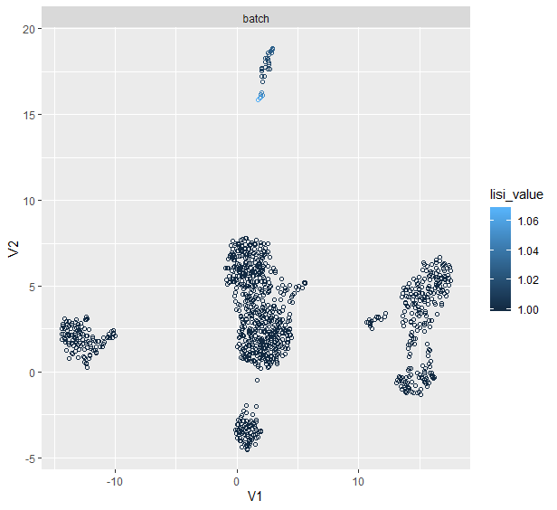
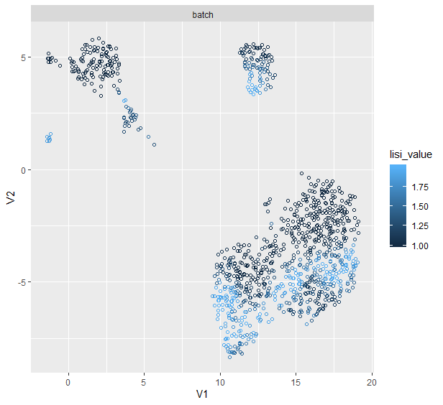
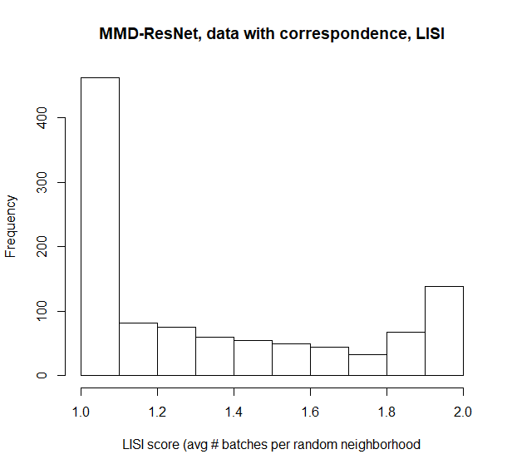
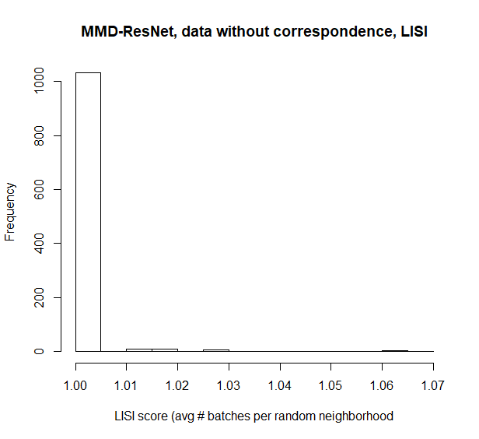
Results: MMD-ResNet
LISI: left is with correspondence, right is without correspondence.

Slide 24
ASW and ARI

